Slide 1
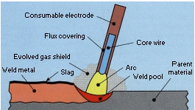
Shielded metal arc welding (Stick welding)
Principle :
Arc is established between metallic electrode and the work piece to be welded.
Consumable electrodes are used.
---Mostly coated electrodes.
---Rarely bare electrodes are used
(Only for low carbon steel and wrought iron).
In this process electrode burns and produces a dense smoke which shields the metal drops during their transfer from electrode to weld pool.
At the same time coating melts and forms slag.
During welding the parent metal also melts and it mixed with electrode material and finally solidified together.

Slide 2
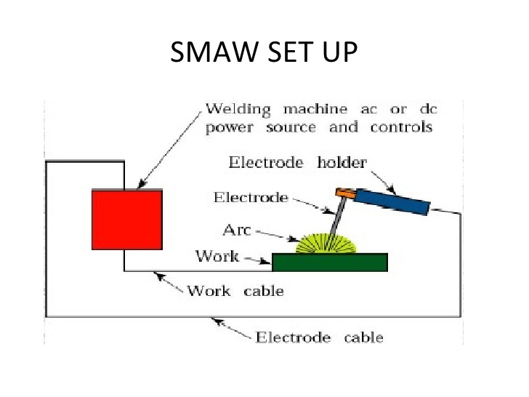

Slide 3
Characteristics.
  SMAW is most extensively used.
  Highly versatile. Suitable for simple and sophisticated jobs.
  Least expensive equipment.
  Any thickness can be welded. But difficulty in t < 3 mm. and large thickness t>20 mm takes long time.
  Power source: AC, DCEN and DCEP.
  Voltage 20-40 Volts, Current 50-500 Amps.
  Weld metal deposition rates ---------1 kg to 8 kg /hour
  Weld positions --------Flat; Horizontal; Vertical and Overhead
  Depending upon thickness ----------single / multipurpose welds

Slide 4
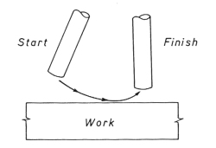
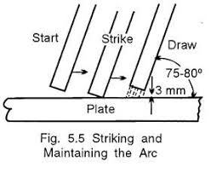
Steps involved in SMAW:
  Preparation of edges ----- flat, single and double V etc.
  Holding the workplace in a fixture.
  Striking the arc
  Welding the joint.

Slide 5
Advantages:
  Versatile. Any position is possible.
  Suitable for wide range of metals.
Disadvantages:
  Low speed compared to other arc welding processes.
  Not suitable for automation.
  Replacement of electrode is required for long welds.
  Less deposition rates.
  Chances of slag entrapment in multi-pass welding
Applications:
For welding of pressure vessels, ships, structural work, repair etc.

Slide 6
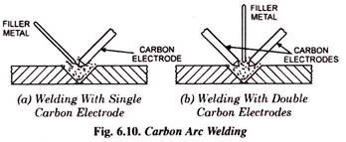
Carbon arc welding (CAW)
Arc is struck between carbon/graphite electrode and work piece or between two carbon electrodes.
Non consumable electrodes ----- carbon or graphite are used.
Carbon electrodes ------softer than graphite hence cannot take higher current densities.

Slide 7
Carbon arc welding (CAW)…..
Arc with carbon electrode is more controllable.
Graphite electrode life is higher than carbon electrode.
Filler material is supplied through a separate filler rod.
Power source DCEN ----- for single electrode CAW
AC -------- for double electrode.
Though carbon or graphite electrodes are not expected to melt, due to high temperature, they slowly disintegrate at tips.
Tip is made conical shape.

Slide 8
Because of the separation of the heat source from filler material, better control of heat input is possible.
Not suitable for vertical and overhead positions.
High welding speeds are possible in flat welding.
Mostly used for welding of nonferrous materials Cu, Al alloys.

Slide 9
Inert gas shielded arc welding
  The gases in atmosphere oxygen, nitrogen, hydrogen etc will interface with the weld pool and detriment the weld quality which results poor mechanical properties of the joint.
  Hence to protect the weld pool from atmospheric gases, inert gases may be used.
  In Inert gas shielded arc welding processes, a high pressure inert gas flowing around the electrode while welding will physically displace all the atmospheric gases around the weld metal to fully protect it.
  Most commonly used inert gases -------- Argon, Helium, Co2 and their mixtures.
  Argon normally preferred over Helium.

Slide 10
Advantages of Argon
  Requires lower arc voltage.
  Allows for easier arc starting.
  Provide smooth arc.
  Longer arc can be maintained since arc voltage does not vary appreciably with arc length.
  More economical.
  It is heaviest and requires low flow rate for good shielding action.
  Suitable for welding thin sections.
  Suitable for vertical/horizontal and overhead positions also (out of position).
  For both AC and DC.

Slide 11
Advantages of Helium
  Can withstand the higher arc voltages. Hence suitable where higher heat input is required i.e., for welding of thicker plates and for materials having higher thermal conductivity like Al, Cu etc.
  For both AC and DC.
Advantages of Co2:
  Most economical.
  It requires slightly higher current which cause more agitation in the weld puddle resulting in the trapped gases to rise and come out. Hence weld porosity reduced.
  Suitable for DCEP (DCRP).
  In DCEN ----unstable arc results.

Slide 12
Inert gas welding:
Tungsten inert gas welding (TIG) or (GTAW)
Metal inert gas welding (MIG) or (GMAW).
Tungsten inert gas welding (TIG) or (GTAW)
  Inert gas shielded arc welding.
  Uses non consumable electrode.
  Electrode material ---Pure Tungsten
  Tungsten + 1-2 % Thorium oxide Tungsten +0.15-0.40 % zirconium oxide
  (To increase current carrying capacity).
Power source: AC & DCEN/ DCEP
DC ------ for Cu, Ti, SS
AC --------for Al
Sometimes uses filler material. Normally bare electrodes.

Slide 13
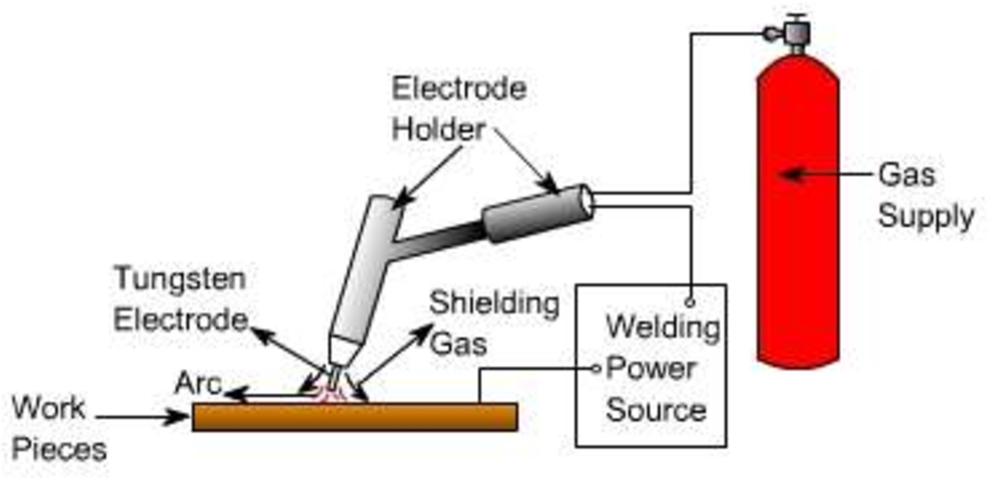
Tungsten inert gas welding (TIG) or (GTAW)

Slide 14
Advantages
  No flux hence no cleaning.
  No atmospheric contamination
  Uniform weld as no slag inclusions.
  Dissimilar welds can be welded easily.
Disadvantages
  Proper cleaning of joint surfaces before welding.
  Slow in operation.
  High cost.
Applications:
  Suitable for various thicknesses,
  For all materials
  Used in welding of components for missiles, rockets, aircrafts etc.

Slide 15
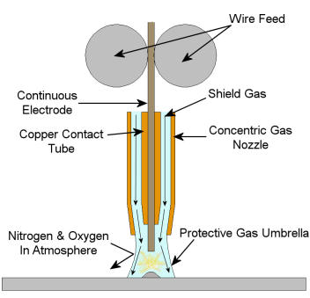
Gas metal arc welding (GMAW or MIG)
  Consumable electrode fed continuously.
  Shielding of the process by inert gases.
  Equipment:
Welding gun ------- carries a nozzle through which the shielding gas exits.
Nozzle maybe air-cooled (for low-power guns or water cooled (for high power guns).
2. Wire drive: The electrode in the form of a wire is fed continuously through drive rolls.
Feed rate is controlled to maintain a constant arc voltage.

Slide 16
The Gas Supply: Inert gases such as Argon, Helium, Co2 or mixtures of above supplied.
Welding machine--------- AC/ DCEN/ DCEP.
    Normally DC machines with DCEP are used as power source.
    DCEP increases metal deposition rate and stable the arc and smooth metal transfer.
  DCEN ----- Arc becomes unstable
  Results large spatter.
  GMAW uses for thicker materials
5. Shielding gases ------- Argon, Helium and Co2.
6. Electrodes: ------- Depends on base metal composition.

Slide 17
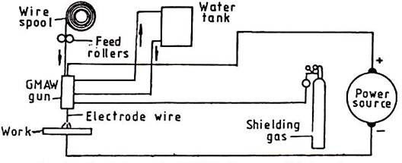
Gas metal arc welding (GMAW or MIG)…

Slide 18
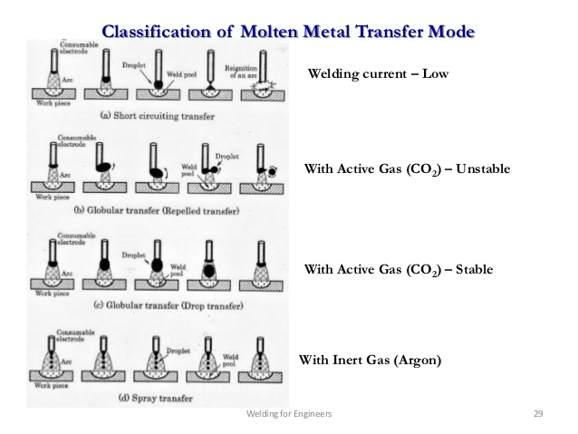
Metal Transfer in GMAW
In GMAW the filler metal is transferred to the joint.
Depending on the current and voltage used for a given electrode, the metal transfer is done in the following methods.
1. Short circuit or Dip Transfer
2. Globular transfer
3. Spray transfer
4. Pulsed spray transfer
5. Rotating spray transfer

Slide 19
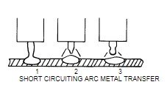
Short circuit or Dip transfer
  Occurs for low current settings (75 to 175 Amps) and small electrode diameter (0.9mm approx.)
  In this type, the electrode forms a droplet shaped metal and contact the molten weld pool and thus short circuits the electrode to the work piece.
  It produces a small weld pool that generally suitable for joining thin sections.
  Because of low heat input, plate distortion will be small.

Slide 20
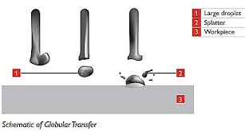
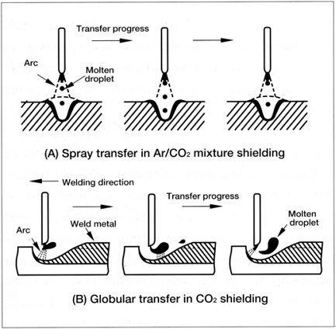
Globular or Drop transfer
Molten metal from electrode is detached and travel under the action of gravity towards weld pool.
This mode occurs with DCRP when current density is relatively low.
Droplet diameter size greater than that of the electrodes.
Since the weld metal is transferred by gravity, this method can only be used for flat welding.
Shielding gas ------- Co2.

Slide 21
Spray transfer
It occurs when the current is increased beyond that of the global transfer.
As the current is increased, the magnetic pull on the molten metal increases and the molten metal is detached from the electrode tip irrespective of the gravity force.
Suitable for any position. (Since gravity has no effect).
High currents approx.300 A
The metal is continuously attracted towards the work by the magnetic force like a spray from a jet.
Shielding gas should be 90% Argon.

Slide 22
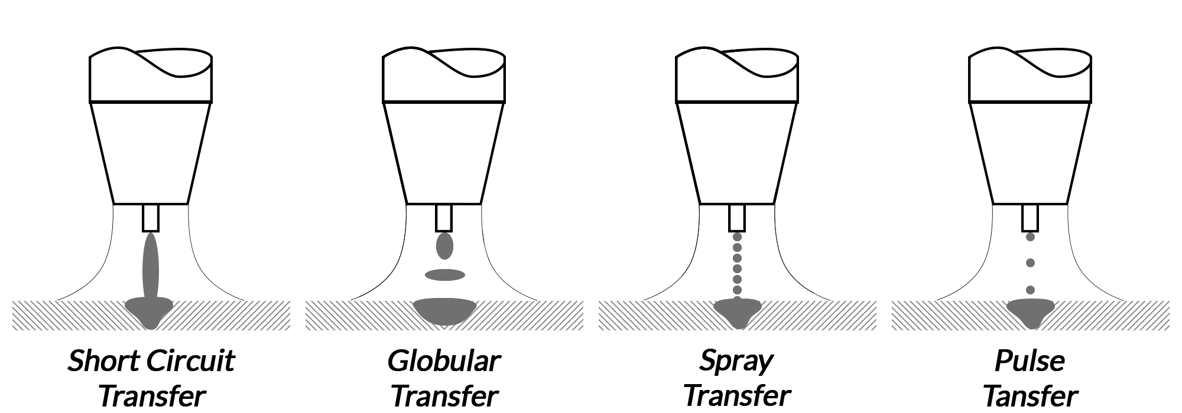
Pulsed Spray transfer
Because of larger heat inputs and deeper penetration, the spray transfer is not suitable for thin materials and for welding out of positions.
For this kind of applications, the pulsed spray transfer is used.
It is similar to spray transfer except that the current is supplied in regular pulses rather than continuously.
Pulsing of current reduces the total heat input to the base metal and thus results in lower metal deposition rates.

Slide 23
Rotating spray transfer
When the welding current is increased beyond the spray transfer, the rotating spray transfer results.
In this method, the end of electrode wire melts and rotates in a spiraling or helical pattern.
Because of this rotation, the weld pool is extended over a large area, resulting in poor penetration.
This method is useful for depositing large amount of metal.

Slide 24
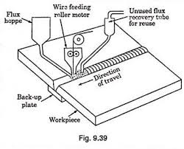
Submerged Arc Welding
Used for longer welds and doing faster welding jobs.
Large electrodes (12 mm dia.), larger currents (4000 A)
High metal deposition rates.
Thicker plates (75 mm thick plates) can be butt welded in single pass.
Arc is produced between continuously fed consumable electrode and work piece.
Weld zone is completely covered by means of large amount of granulated flux.

Slide 25
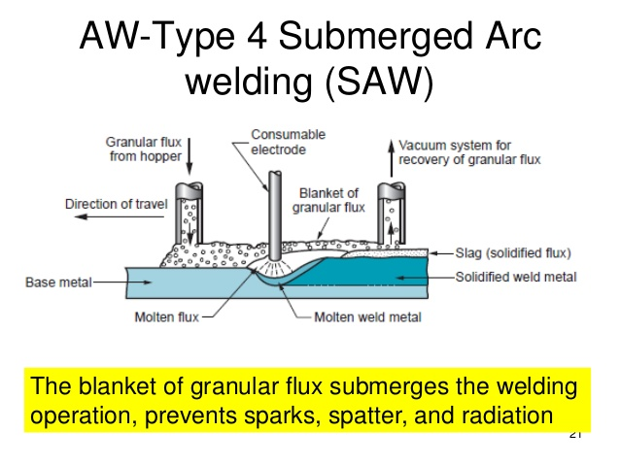
The arc is completely submerged under the flux and not visible from outside.
Part of the flux is melted and forms slag.
Unused flux is collected and reused.
Power source -------- both AC and DC.

Slide 26
Advantages
No spatter of the weld metal since the arc is submerged in flux.
Since granulated flux is used, suitable only for flat and horizontal welding. (Not suitable for vertical and overhead welding).
As penetration is high, backup plate is required.
Higher deposition rates (90 kgs/hour
High speeds
High quality weld (since flux is covering the weld zone).

Slide 27
Disadvantages
  Costly equipment
  Not flexible
  Not suitable for all positions
  Not economical for thin plates.
Applications
  Best suitable for continuous welding of thick plates.
  Used for Carbon and alloy steels, stainless steels.
  Welding of pressure vessels, boiler plates, pipes

Slide 28
THANK YOU

